Slide 1
Process Assessment Report
CIS RABET-V Pilot
Acme Non-voting Tech
SAMPLE
Notes:
This is an example of the output that is presented to vendors participating in the RABET-V process.
The goal is not only to assess and score the software assurance processes, but to help contribute to the improvement of these processes which should result in more secure software in the future.

Slide 2
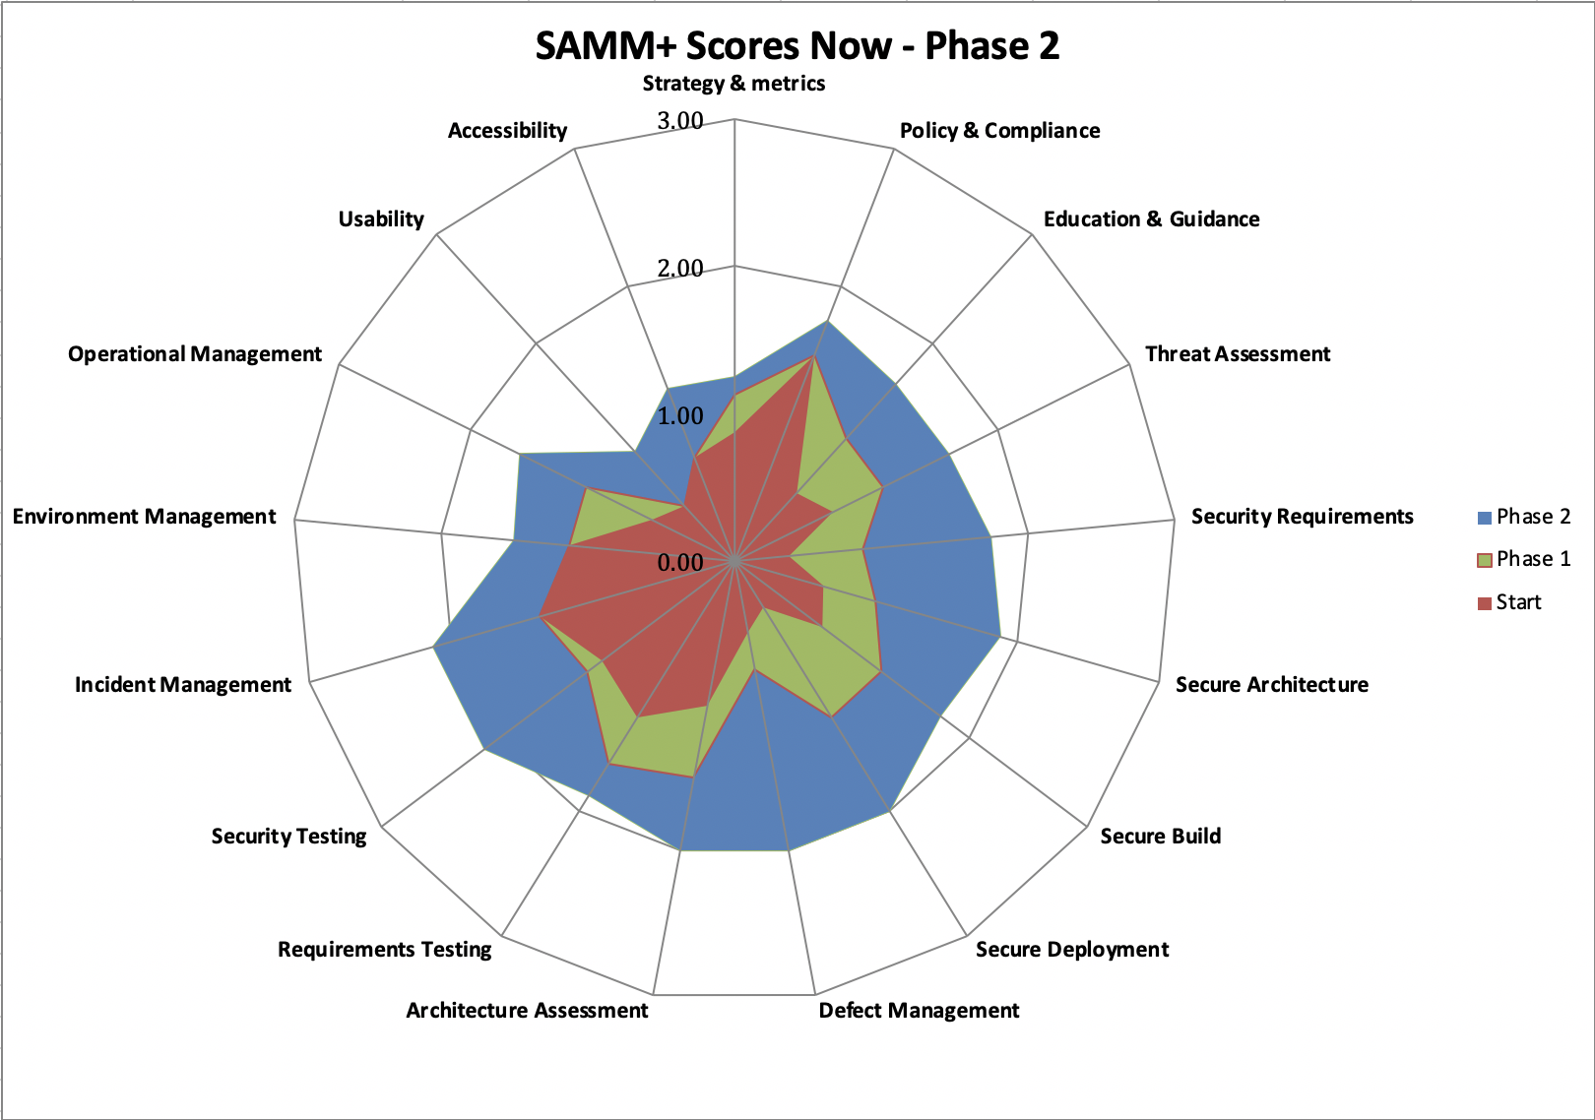
Executive Summary
Acme Non-Voting’s initial SAMM+ score is considered on the lower end of normal for an organization. Typically organizations are around 0.8-1.2 on average, Acme Non-Voting composite score is 0.82.
Acme Non-Voting’s current secure development efforts are largely driven by ...
Implementing the recommendations in Phases I & II will help improve security posture and streamline reviews for RABET-V
To maintain and improve the current security levels, Acme Non-Voting needs to move beyond ...
…
Notes:
Executive summary.
High level description of the overall score as determined from interviews and document reviews.
The initial score ranges are currently based on many years of experience in conducting SAMM assessments.
There is currently a SAMM Benchmarking project underway that will help build a knowledge base of organizational scores that can be used in the future.
The hope is that the RABET-V process can also help contribute to the Benchmark project itself.
The slide shows a spider diagram of the current state, along with projected scored based on changes in answers from completing recommended activities.
There are a couple high level observations as well.

Slide 3
Program Review Process
The RABET-V team reviewed existing documentation related to organizational structure, development processes, and security standards.
The RABET-V team talked with ## different people in ## virtual sessions to gain an understanding of the current processes, standards, education, goals, etc.
Best practices related to integrating security into programs, processes, and procedures were applied as applicable for Acme Non-Voting’s current state, culture, and risk profile.
The RABET-V team leveraged the Software Assurance Maturity Model (SAMM v2.0) framework to measure the current state, and project maturity improvements based on recommended activities in support of the RABET-V model along with usability and accessibility guidance.
High Level Recommendations were developed for Acme Non-Voting based on the stated goals, understanding of current state, and culture.
Notes:
This slide describes the process at a high level for people that may not have been part of it.
Uses the SAMM framework but does it as a dialog to understand how things are done for software.

Slide 4
Software Assurance Maturity Model
The Software Assurance Maturity Model (SAMM) is an open framework to help organizations formulate and implement a strategy for software security that is tailored to the specific risks facing the organization.
The resources provided by SAMM will aid in:
Evaluating an organization’s existing software security practices.
Building a balanced software security assurance program in well-defined iterations.
Demonstrating concrete improvements to a security assurance program.
Defining and measuring security-related activities throughout an organization.
https://owaspsamm.org/
Notes:
Basic description of the Software Assurance Maturity Model (SAMM) that is the basis of the process assessment.

Slide 5
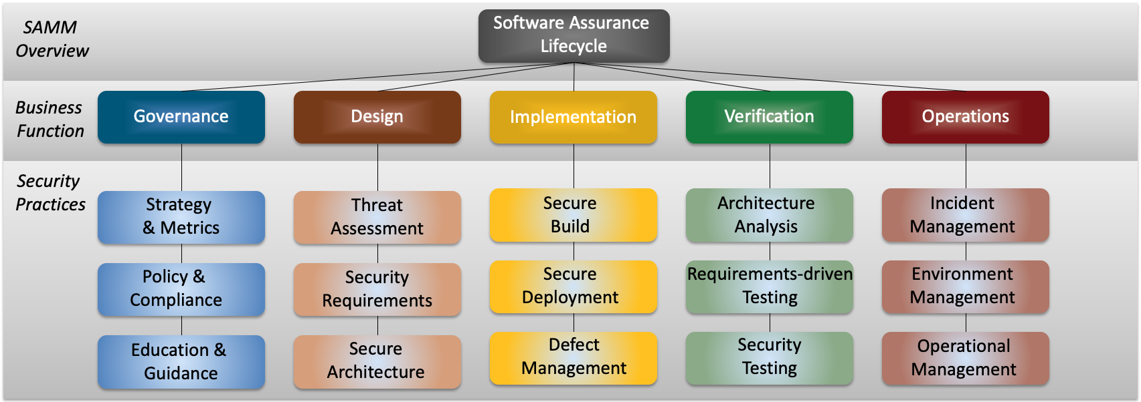
SAMM Framework
For each of the five Business Functions, three Security Practices are defined
The security practices cover areas relevant to software security assurance
For RABET-V we enhanced SAMM with Usability and Accessibility measurements
Notes:
Breakdown of why SAMM covers the full software assurance lifecycle.
It’s not just about secure coding, it’s everything else from a strategic plan, to education, architectures and design, OSS management, CI/CD, testing, infrastructure, incident response, and so on.

Slide 6
Acme Non-Voting Current Status
Leveraging AWS services for several security services
Dependencies are maintained in an ad-hoc manner
Working on changes to process and design to remove secrets from code
Good automated feature and unit test suite
Pen testing and code review for each full release
Solid onboarding practices for developers earning access to code/systems
…
Notes:
High level points condensed from the several interviews to provide a high-level summary.
Generally the neutral and positive items that are found.

Slide 7
Acme Non-Voting Challenges
Need to ensure accessibility and usability are included in the design and testing processes
Need to mature documentation and processes to support growth and security
Missing high level standards and principles to guide architecture and development
There are individuals with expertise about application risk, but nothing formal yet
…
Need tooling and automation to help efficiently support developers and testers
…
Notes:
The challenges are usually focused on the areas that need focus, attention, improvements.

Slide 8


Process Artifacts
Change List
This is the most important software development artifact used by RABET-V when performing verification of Product Revisions. It is critical that the list is accurate, detailed, and complete. While RTPs can submit manually generated change lists, they may take longer to process than automated change lists built from the central source code repository and reviewed by system architects and product owners.
Automated Configuration Assessments
Security configurations are a major part of ensuring that systems contain properly implementing security controls. Using configuration guidance, such as the CIS Benchmarks, leads to consistent security outcomes. Using automated configuration assessment tools, such as the CIS configuration assessment tool (CIS-CAT) can ensure guidance is being followed for every release. Results may be used in leu of additional testing by RABET-V production verification.
Automated Vulnerability Assessments
Automated vulnerability assessments check system components for known vulnerabilities. These assessments primarily check third party components for known vulnerable versions of software. Results may be used in leu of additional testing by RABET-V production verification.
Automated Unit Testing
Automated unit testing is a way to regression test large and complex applications efficiently. It takes significant investment on the part of the technology provider to build test suites that are robust and accurate. Results may be used in leu of additional testing by RABET-V production verification.
3rd Party Security Analysis
Third-party security testing of the system, if performed against a reliable standard and performed recently, can be used in RABET-V in lieu of repeating similar evaluations.
Notes:
List of artifacts that are requested as part of the process assessment.
These artifacts will help us understand the quality of the output of these activities and we believe contribute to being able to help refine testing later in the process.

Slide 9
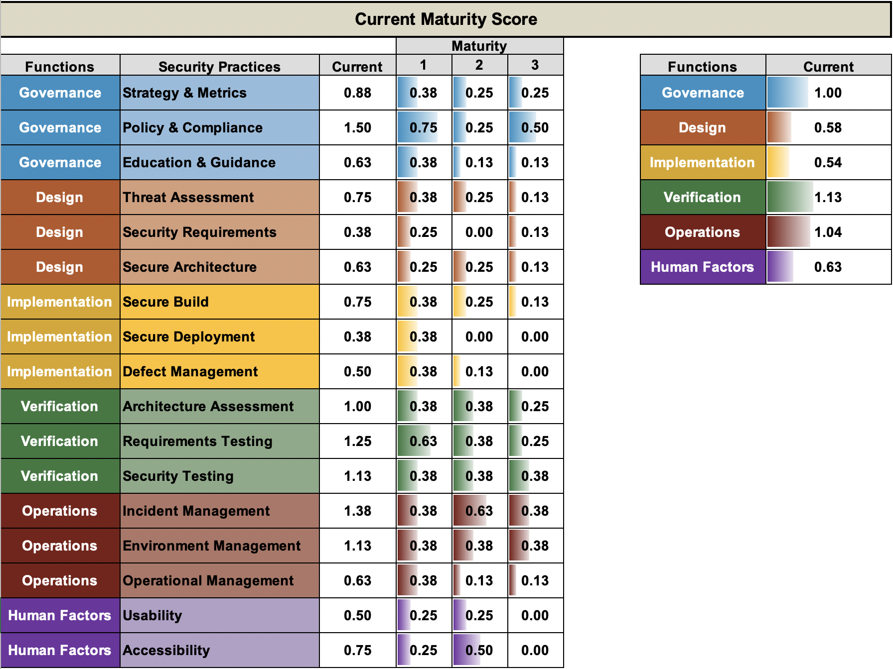
Current SAMM+ Results
Overall composite score is 0.82
Notes:
Dashboard summary of the results from the interviews and documentation review.
Shows what areas are contributing to the scores and which one has clear gaps.
The Human Factors is added to SAMM to help address Usability and Accessibility (which is why we refer to it as SAMM+)

Slide 10
Recommendations Phase I
Document Policy and Standards
High-level policies and standards to ensure a common understanding and secure baseline.
Application Risk Categorization w/ Data Classification
Understand how much effort should be undertaken for each application/system to efficiently manage risk and ensure data is protected.
…
Policy
Standards
Principles
Tech Agnostic
Tech Specific
Guidelines
Requirements/ User Stories
Test Cases
Notes:
Recommendations are broken into two Phases.
These phases are not time bound as each organization had different resources and priorities.
We go into a little more detail in Phase I as it is the first round, the second phase is lighter as much will likely change before then.
This is a high-level summary, there are typically a slide or two dedicated to providing more information about each of the recommendations.

Slide 11
Security Policy and Standards
Security Standards must be technology agnostic. They should be static, however, if vulnerabilities are found without a matching expectation, consider updating them. Code reviews should be conducted with these standards in mind.
Authentication
Username
Password, MFA
Account Management
Authorization
Role-Based Access Control
Attribute-Based Access Control
Rule-Based Access Control
Input Handling
Test input for type, length, context
Output encode contextually
Privacy
Access to customer/client data
Cryptography
Standard algorithms, strengths, and modes
…
Notes:
Example guidance related to Policy and Standards

Slide 12
Application Risk Categorization
Understand inherent risk of applications
Prioritize resources and security investments
Gain a better understanding of the risk presented by the applications
Process for completion and maintenance of application catalog
Data Classification (example):
Privileged and Confidential
Sensitive
Internal
Public
Inherent Risk
“…is an assessed level of raw or untreated risk; that is, the natural level of risk inherent in a process or activity without doing anything to reduce the likelihood or mitigate the severity of a mishap, or the amount of risk before the application of the risk reduction effects of controls.”
Gregory Monahan (2008). Enterprise Risk Management: A Methodology for Achieving Strategic Objectives. John Wiley & Sons

Slide 13
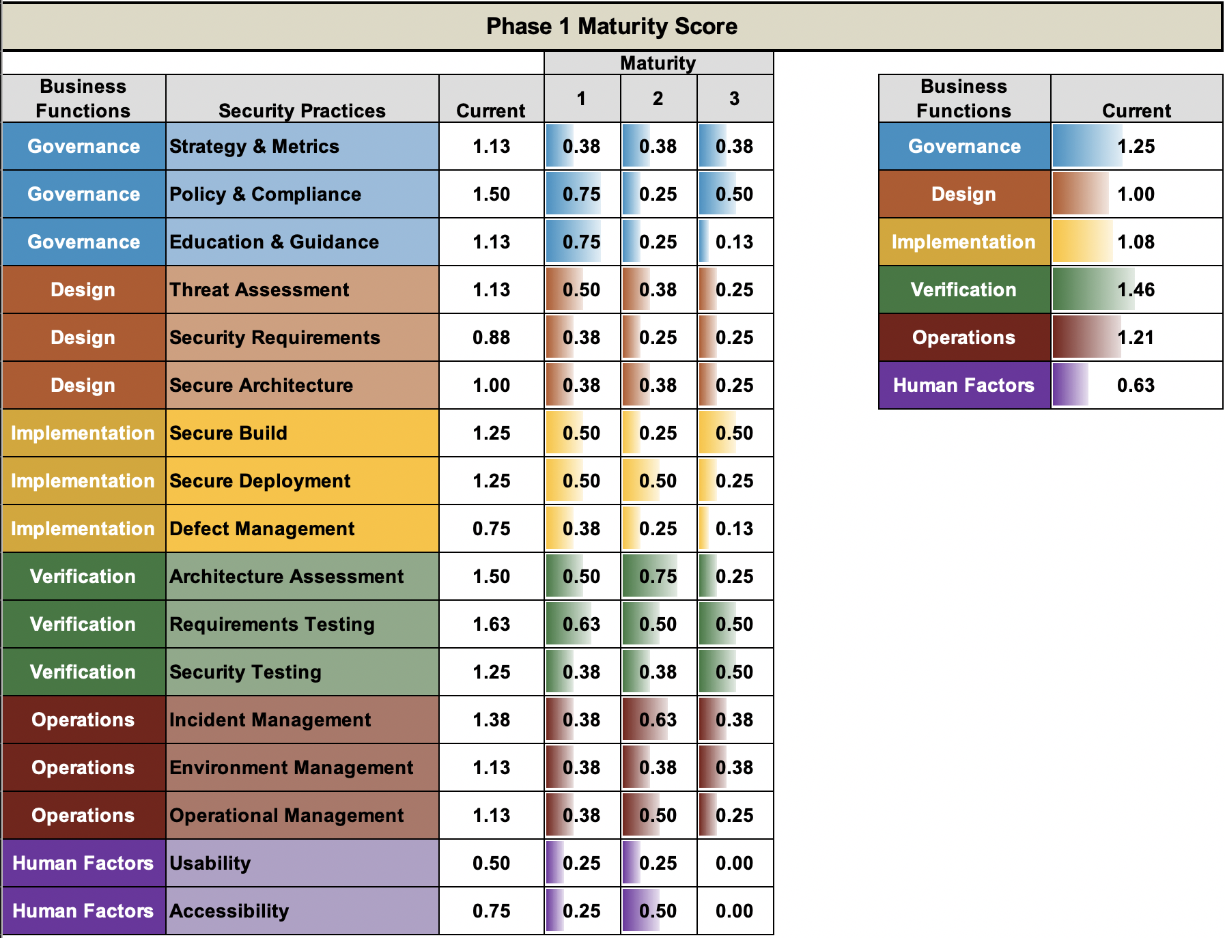
Projected Score after Phase I
Overall composite score would be 1.10
(Projection based on the change in answers from completing the recommended activities.)
Notes:
Typically there are 5-7 recommended initiatives in Phase I.
The SAMM roadmap allows us to project the changes to answers for related questions and predict the scoring improvements.

Slide 14
Recommendations Phase II
Secure Update and Distribution
Code signing, obfuscation, and other supporting security update mechanisms help ensure the integrity of the software distributed for clients.
Security Metrics
Gain insight into how well security is implemented, reduction in risk, improvements over time. SLAs and KPIs should be developed to provide insight into short and long term trends in software security within the organization. Pulling from data sources like security testing and vulnerability management.
…
Improve Audit/Logging and Incident Response capabilities
Enhance and enable audit logging within the infrastructure and at the application levels to help detect and alert when attacked. Run incident response drills to help ensure that you are ready when the time comes.
Notes:
Phase II recommendations are lighter weight as they are further into the future

Slide 15
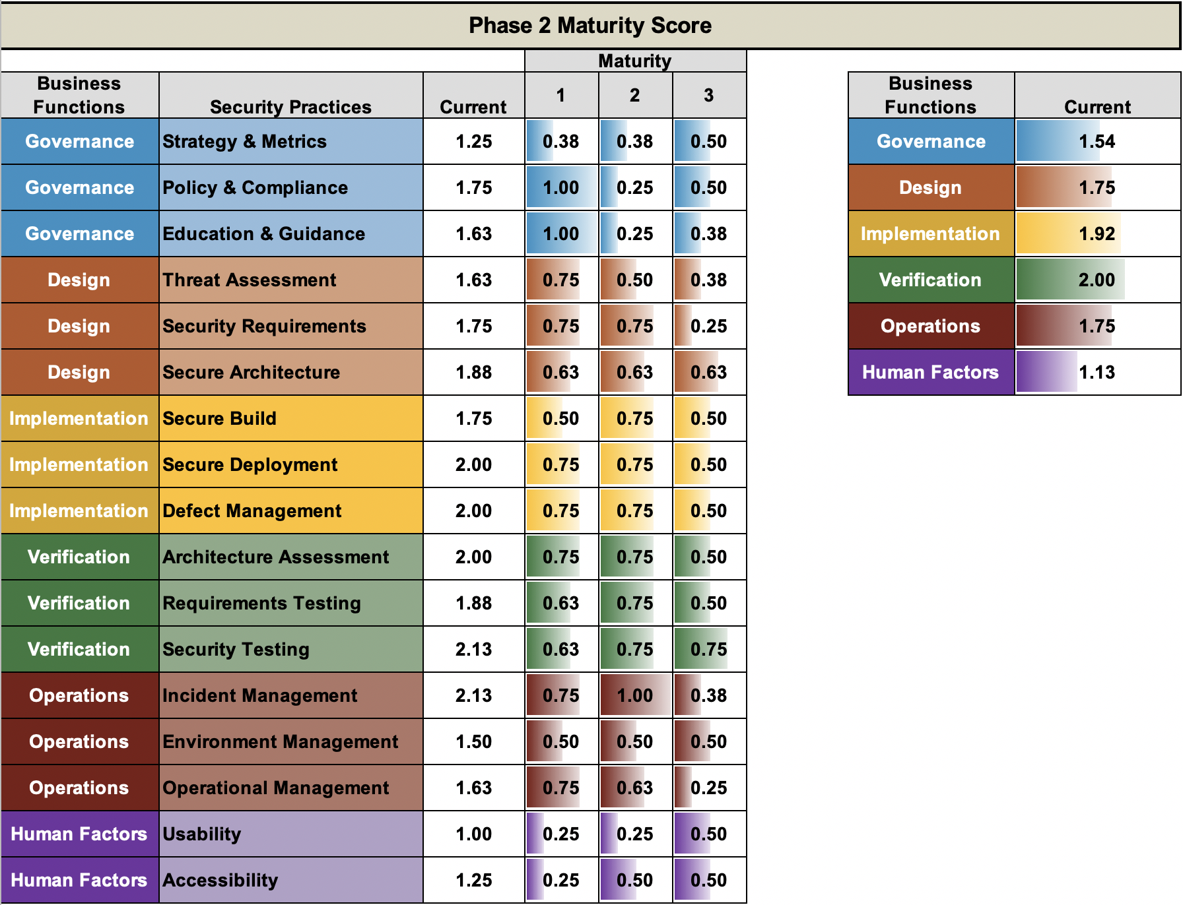
Projected Score after Phase II
Overall composite score would be 1.68
(Projection based on the change in answers from completing the recommended activities.)
Notes:
The projected score improvements include continued work from Phase I along with updates from Phase II.

Slide 16
SAMM Phased Improvement Score
Notes:
Final summary of the overall scoring.
We are in the process of analyzing the results of the two pilot process assessments along with the scoring from architecture assessments and claims verification to see what we can determine for correlations and how we can tune the process to help ensure a high level of software assurance overall without making the process to heavy and costly.

